Slide 1

CSE 4109: Artificial Intelligence, Bayesian Network

Slide 2
Bayesian Networks: A Tutorial
Modified by
Longin Jan Latecki
Temple University
latecki@temple.edu

Slide 3

Introduction
Suppose you are trying to determine if a patient has inhalational anthrax. You observe the following symptoms:
The patient has a cough
The patient has a fever
The patient has difficulty breathing
CSE 4109: Artificial Intelligence, Bayesian Network

Slide 4
Introduction
You would like to determine how likely the patient is infected with inhalational anthrax given that the patient has a cough, a fever, and difficulty breathing
We are not 100% certain that the patient has anthrax because of these symptoms. We are dealing with uncertainty!
CSE 4109: Artificial Intelligence, Bayesian Network

Slide 5

Introduction
Now suppose you order an x-ray and observe that the patient has a wide mediastinum.
Your belief that that the patient is infected with inhalational anthrax is now much higher.
CSE 4109: Artificial Intelligence, Bayesian Network

Slide 6
Introduction
In the previous slides, what you observed affected your belief that the patient is infected with anthrax
This is called reasoning with uncertainty
Wouldn’t it be nice if we had some methodology for reasoning with uncertainty? Well in fact, we do…
CSE 4109: Artificial Intelligence, Bayesian Network

Slide 7
Bayesian Networks
HasAnthrax
HasCough
HasFever
HasDifficultyBreathing
HasWideMediastinum
In the opinion of many AI researchers, Bayesian networks are the most significant contribution in AI in the last 20 years
They are used in many applications eg. spam filtering, speech recognition, robotics, diagnostic systems and even syndromic surveillance
CSE 4109: Artificial Intelligence, Bayesian Network

Slide 8
Outline
Introduction
Probability Primer
Bayesian Networks
CSE 4109: Artificial Intelligence, Bayesian Network

Slide 9

Probability Primer: Random Variables
A random variable is the basic element of probability
Refers to an event and there is some degree of uncertainty as to the outcome of the event
For example, the random variable A could be the event of getting a head on a coin flip
CSE 4109: Artificial Intelligence, Bayesian Network

Slide 10
Boolean Random Variables
We will start with the simplest type of random variables – Boolean ones
Take the values true or false
Think of the event as occurring or not occurring
Examples (Let A be a Boolean random variable):
  A = Getting a head on a coin flip
  A = It will rain today
CSE 4109: Artificial Intelligence, Bayesian Network

Slide 11
The Joint Probability Distribution
Joint probabilities can be between any number of variables
eg. P(A = true, B = true, C = true)
For each combination of variables, we need to say how probable that combination is
The probabilities of these combinations need to sum to 1
A | B | C | P(A,B,C)
false | false | false | 0.1
false | false | true | 0.2
false | true | false | 0.05
false | true | true | 0.05
true | false | false | 0.3
true | false | true | 0.1
true | true | false | 0.05
true | true | true | 0.15
Sums to 1
CSE 4109: Artificial Intelligence, Bayesian Network

Slide 12
The Joint Probability Distribution
A | B | C | P(A,B,C)
false | false | false | 0.1
false | false | true | 0.2
false | true | false | 0.05
false | true | true | 0.05
true | false | false | 0.3
true | false | true | 0.1
true | true | false | 0.05
true | true | true | 0.15
Once you have the joint probability distribution, you can calculate any probability involving A, B, and C
Note: May need to use marginalization and Bayes rule, (both of which are not discussed in these slides)
Examples of things you can compute:
P(A=true) = sum of P(A,B,C) in rows with A=true
P(A=true, B = true | C=true) =
P(A = true, B = true, C = true) / P(C = true)
CSE 4109: Artificial Intelligence, Bayesian Network

Slide 13
The Problem with the Joint Distribution
Lots of entries in the table to fill up!
For k Boolean random variables, you need a table of size 2^{k}
How do we use fewer numbers? Need the concept of independence
A | B | C | P(A,B,C)
false | false | false | 0.1
false | false | true | 0.2
false | true | false | 0.05
false | true | true | 0.05
true | false | false | 0.3
true | false | true | 0.1
true | true | false | 0.05
true | true | true | 0.15
CSE 4109: Artificial Intelligence, Bayesian Network

Slide 14
Independence
Variables A and B are independent if any of the following hold:
P(A,B) = P(A) P(B)
P(A | B) = P(A)
P(B | A) = P(B)
This says that knowing the outcome of A does not tell me anything new about the outcome of B.
CSE 4109: Artificial Intelligence, Bayesian Network

Slide 15
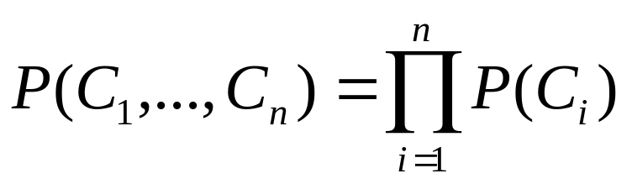
Independence
How is independence useful?
Suppose you have n coin flips and you want to calculate the joint distribution P(C₁, …, C_{n})
If the coin flips are not independent, you need 2^{n} values in the table
If the coin flips are independent, then
Each P(C_{i}) table has 2 entries and there are n of them for a total of 2n values
CSE 4109: Artificial Intelligence, Bayesian Network

Slide 16
Conditional Independence
Variables A and B are conditionally independent given C if any of the following hold:
P(A, B | C) = P(A | C) P(B | C)
P(A | B, C) = P(A | C)
P(B | A, C) = P(B | C)
Knowing C tells me everything about B. I don’t gain anything by knowing A (either because A doesn’t influence B or because knowing C provides all the information knowing A would give)
CSE 4109: Artificial Intelligence, Bayesian Network

Slide 17
Outline
Introduction
Probability Primer
Bayesian networks
CSE 4109: Artificial Intelligence, Bayesian Network

Slide 18
A Bayesian Network
A Bayesian network is made up of:
1. A Directed Acyclic Graph
A
B
C
D
2. A set of tables for each node in the graph
A | P(A)
false | 0.6
true | 0.4
A | B | P(B|A)
false | false | 0.01
false | true | 0.99
true | false | 0.7
true | true | 0.3
B | D | P(D|B)
false | false | 0.02
false | true | 0.98
true | false | 0.05
true | true | 0.95
B | C | P(C|B)
false | false | 0.4
false | true | 0.6
true | false | 0.9
true | true | 0.1
CSE 4109: Artificial Intelligence, Bayesian Network

Slide 19
A Directed Acyclic Graph
Each node in the graph is a random variable
A node X is a parent of another node Y if there is an arrow from node X to node Y eg. A is a parent of B
A
B
C
D
Informally, an arrow from node X to node Y means X has a direct influence on Y
CSE 4109: Artificial Intelligence, Bayesian Network

Slide 20
A Set of Tables for Each Node
A | P(A)
false | 0.6
true | 0.4
A | B | P(B|A)
false | false | 0.01
false | true | 0.99
true | false | 0.7
true | true | 0.3
Each node X_{i} has a conditional probability distribution P(X_{i} | Parents(X_{i})) that quantifies the effect of the parents on the node
The parameters are the probabilities in these conditional probability tables (CPTs)
B | C | P(C|B)
false | false | 0.4
false | true | 0.6
true | false | 0.9
true | true | 0.1
A
B
B | D | P(D|B)
false | false | 0.02
false | true | 0.98
true | false | 0.05
true | true | 0.95
C
D
CSE 4109: Artificial Intelligence, Bayesian Network

Slide 21
A Set of Tables for Each Node
Conditional Probability Distribution for C given B
B | C | P(C|B)
false | false | 0.4
false | true | 0.6
true | false | 0.9
true | true | 0.1
For a given combination of values of the parents (B in this example), the entries for P(C=true | B) and P(C=false | B) must add up to 1
eg. P(C=true | B=false) + P(C=false |B=false )=1
If you have a Boolean variable with k Boolean parents, this table has 2^{k+1} probabilities (but only 2^{k} need to be stored)
CSE 4109: Artificial Intelligence, Bayesian Network

Slide 22
Bayesian Networks
Two important properties:
Encodes the conditional independence relationships between the variables in the graph structure
Is a compact representation of the joint probability distribution over the variables
CSE 4109: Artificial Intelligence, Bayesian Network

Slide 23
Conditional Independence
The Markov condition: given its parents (P₁, P₂),
a node (X) is conditionally independent of its non-descendants (ND₁, ND₂)
P₁
P₂
ND₁
X
ND₂
C₁
C₂
CSE 4109: Artificial Intelligence, Bayesian Network

Slide 24
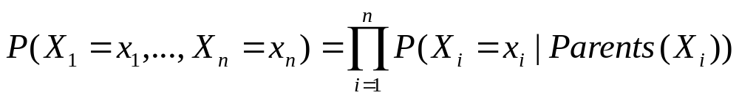
The Joint Probability Distribution
Due to the Markov condition, we can compute the joint probability distribution over all the variables X₁, …, X_{n} in the Bayesian net using the formula:
Where Parents(X_{i}) means the values of the Parents of the node X_{i} with respect to the graph
CSE 4109: Artificial Intelligence, Bayesian Network

Slide 25
Using a Bayesian Network Example
Using the network in the example, suppose you want to calculate:
P(A = true, B = true, C = true, D = true)
= P(A = true) * P(B = true | A = true) *
P(C = true | B = true) P( D = true | B = true)
= (0.4)*(0.3)*(0.1)*(0.95)
A
B
C
D
CSE 4109: Artificial Intelligence, Bayesian Network

Slide 26
Using a Bayesian Network Example
Using the network in the example, suppose you want to calculate:
P(A = true, B = true, C = true, D = true)
= P(A = true) * P(B = true | A = true) *
P(C = true | B = true) P( D = true | B = true)
= (0.4)*(0.3)*(0.1)*(0.95)
This is from the graph structure
A
B
These numbers are from the conditional probability tables
C
D
CSE 4109: Artificial Intelligence, Bayesian Network

Slide 27
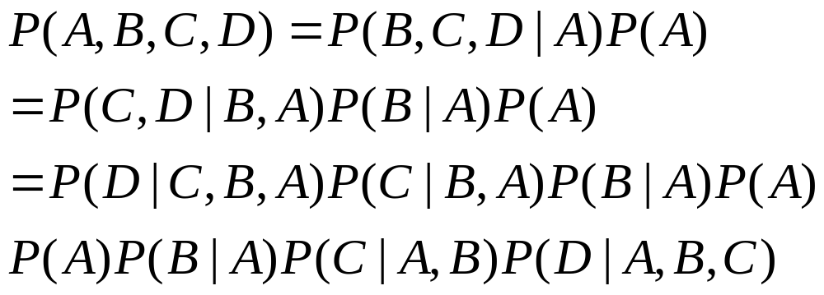
Joint Probability Factorization
For any joint distribution of random variables the following factorization is always true:
We derive it by repeatedly applying the Bayes’ Rule
P(X,Y)=P(X|Y)P(Y):
CSE 4109: Artificial Intelligence, Bayesian Network

Slide 28
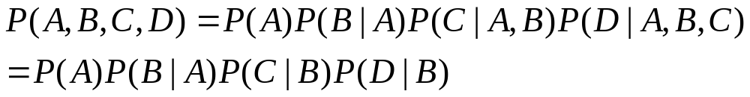
Joint Probability Factorization
Our example graph carries additional independence information, which simplifies the joint distribution:
This is why, we only need the tables for
P(A), P(B|A), P(C|B), and P(D|B)
and why we computed
P(A = true, B = true, C = true, D = true)
= P(A = true) * P(B = true | A = true) *
P(C = true | B = true) P( D = true | B = true)
= (0.4)*(0.3)*(0.1)*(0.95)
A
B
C
D
CSE 4109: Artificial Intelligence, Bayesian Network

Slide 29
Inference
Using a Bayesian network to compute probabilities is called inference
In general, inference involves queries of the form:
P( X | E )
E = The evidence variable(s)
X = The query variable(s)
CSE 4109: Artificial Intelligence, Bayesian Network

Slide 30
Inference
HasAnthrax
HasCough
HasFever
HasDifficultyBreathing
HasWideMediastinum
An example of a query would be:
P( HasAnthrax = true | HasFever = true, HasCough = true)
Note: Even though HasDifficultyBreathing and HasWideMediastinum are in the Bayesian network, they are not given values in the query (ie. they do not appear either as query variables or evidence variables)
They are treated as unobserved variables and summed out.
CSE 4109: Artificial Intelligence, Bayesian Network

Slide 31
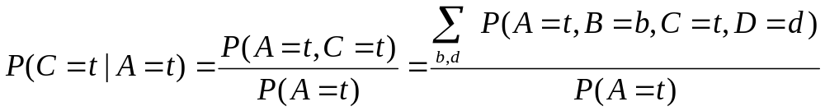
Inference Example
A
Supposed we know that A=true.
What is more probable C=true or D=true?
For this we need to compute
P(C=t | A =t) and P(D=t | A =t).
Let us compute the first one.
B
C
D
A | P(A)
false | 0.6
true | 0.4
A | B | P(B|A)
false | false | 0.01
false | true | 0.99
true | false | 0.7
true | true | 0.3
B | D | P(D|B)
false | false | 0.02
false | true | 0.98
true | false | 0.05
true | true | 0.95
B | C | P(C|B)
false | false | 0.4
false | true | 0.6
true | false | 0.9
true | true | 0.1
CSE 4109: Artificial Intelligence, Bayesian Network

Slide 32
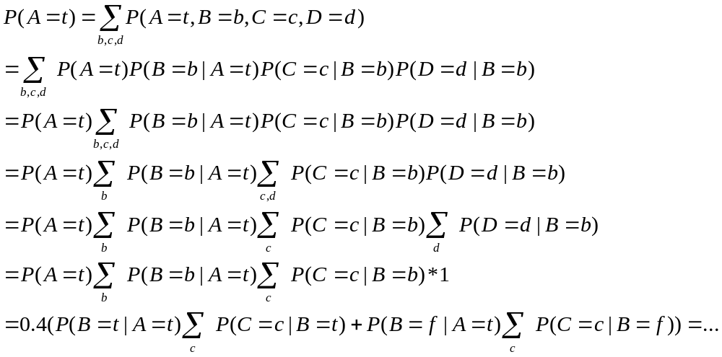
What is P(A=true)?
A
B
C
D
A | P(A)
false | 0.6
true | 0.4
A | B | P(B|A)
false | false | 0.01
false | true | 0.99
true | false | 0.7
true | true | 0.3
B | D | P(D|B)
false | false | 0.02
false | true | 0.98
true | false | 0.05
true | true | 0.95
B | C | P(C|B)
false | false | 0.4
false | true | 0.6
true | false | 0.9
true | true | 0.1
CSE 4109: Artificial Intelligence, Bayesian Network

Slide 33
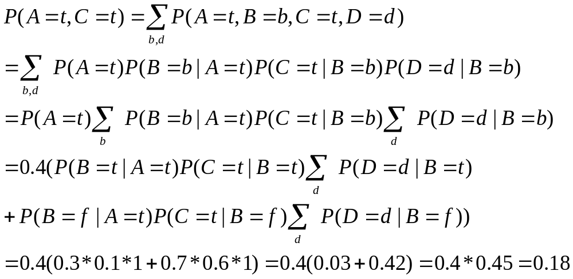
What is P(C=true, A=true)?
A
B
C
D
A | P(A)
false | 0.6
true | 0.4
A | B | P(B|A)
false | false | 0.01
false | true | 0.99
true | false | 0.7
true | true | 0.3
B | D | P(D|B)
false | false | 0.02
false | true | 0.98
true | false | 0.05
true | true | 0.95
B | C | P(C|B)
false | false | 0.4
false | true | 0.6
true | false | 0.9
true | true | 0.1
CSE 4109: Artificial Intelligence, Bayesian Network

Slide 34
The Bad News
Exact inference is feasible in small to medium-sized networks
Exact inference in large networks takes a very long time
We resort to approximate inference techniques which are much faster and give pretty good results
CSE 4109: Artificial Intelligence, Bayesian Network

Slide 35
One last unresolved issue…
We still haven’t said where we get the Bayesian network from. There are two options:
Get an expert to design it
Learn it from data, e.g., the same way as in the lecture on Bayes Classifier in Ch. 8.
CSE 4109: Artificial Intelligence, Bayesian Network

Slide 36
Sampling Bayesian Networks

Slide 37
Sampling
Generate random samples and compute values of interest from samples, not original network
Input: Bayesian network with set of nodes X
Sample = a tuple with assigned values
s=(X₁=x₁,X₂=x₂,… ,X_{k}=x_{k})
Tuple may include all variables (except evidence E) or a subset
Sampling schemas dictate how to generate samples (tuples)
Ideally, samples are distributed according to P(X|E)
CSE 4109: Artificial Intelligence, Bayesian Network

Slide 38
Sampling
Idea: generate a set of samples T
Estimate P(X_{i}|E) from samples
Need to know:
  How to generate a new sample ?
  How many samples T do we need ?
  How to estimate P(X_{i}|E) ?
CSE 4109: Artificial Intelligence, Bayesian Network

Slide 39
Sampling Algorithms
Forward Sampling
Likelyhood Weighting
Gibbs Sampling (MCMC)
  Blocking
  Rao-Blackwellised
Importance Sampling
Sequential Monte-Carlo (Particle Filtering) in Dynamic Bayesian Networks
CSE 4109: Artificial Intelligence, Bayesian Network

Slide 40
Forward Sampling
Forward Sampling
  Case with No evidence
  Case with Evidence
  N and Error Bounds
CSE 4109: Artificial Intelligence, Bayesian Network

Slide 41
Forward Sampling No Evidence
(Henrion 1988)
Input: Bayesian network
X= {X₁,…,X_{N}}, N- #nodes, T - # samples
Output: T samples
Process nodes in topological order – first process the ancestors of a node, then the node itself:
For t = 0 to T
For i = 0 to N
X_{i} ← sample x_{i}^{t} from P(x_{i} | pa_{i})
CSE 4109: Artificial Intelligence, Bayesian Network

Slide 42
Sampling A Value
What does it mean to sample x_{i}^{t} from P(X_{i} | pa_{i}) ?
Assume D(X_{i})={0,1}
Assume P(X_{i} | pa_{i}) = (0.3, 0.7)
Draw a random number r from [0,1]
If r falls in [0,0.3], set X_{i} = 0
If r falls in [0.3,1], set X_{i}=1
0
0.3
r
1
CSE 4109: Artificial Intelligence, Bayesian Network

Slide 43
Sampling a Value
When we sample x_{i}^{t} from P(X_{i} | pa_{i}),
most of the time, will pick the most likely value of X_{i}
occasionally, will pick the unlikely value of X_{i}
We want to find high-probability tuples
But!!!….
Choosing unlikely value allows to “cross” the low probability tuples to reach the high probability tuples !
CSE 4109: Artificial Intelligence, Bayesian Network

Slide 44
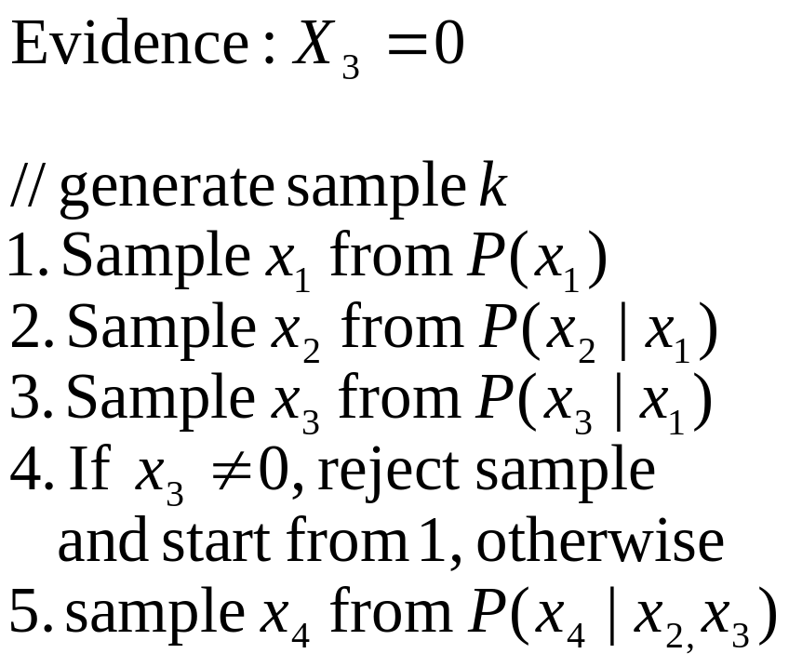


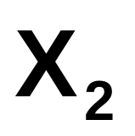
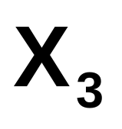
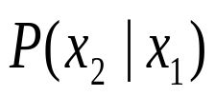

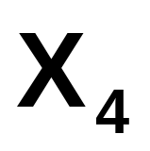
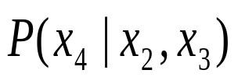
Forward sampling (example)
CSE 4109: Artificial Intelligence, Bayesian Network

Slide 45
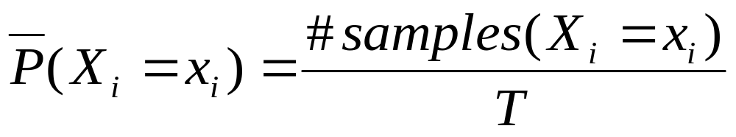
Forward Sampling-Answering Queries
Task: given n samples {S¹,S²,…,S^{n}}
estimate P(X_{i} = x_{i}) :
Basically, count the proportion of samples where X_{i} = x_{i}
CSE 4109: Artificial Intelligence, Bayesian Network

Slide 46
Forward Sampling w/ Evidence
Input: Bayesian network
X= {X₁,…,X_{N}}, N- #nodes
E – evidence, T - # samples
Output: T samples consistent with E
For t=1 to T
For i=1 to N
X_{i} ← sample x_{i}^{t} from P(x_{i} | pa_{i})
If X_{i} in E and X_{i} ≠ x_{i}, reject sample:
i = 1 and go to step 2
CSE 4109: Artificial Intelligence, Bayesian Network

Slide 47
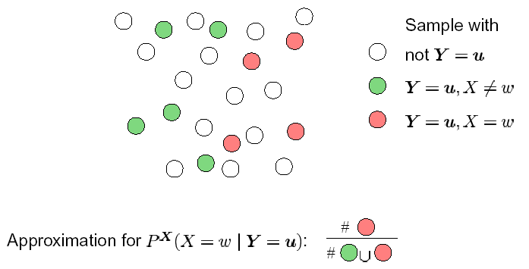
Forward Sampling: Illustration
Let Y be a subset of evidence nodes s.t. Y=u
CSE 4109: Artificial Intelligence, Bayesian Network

Slide 48
Gibbs Sampling
Markov Chain Monte Carlo method
(Gelfand and Smith, 1990, Smith and Roberts, 1993, Tierney, 1994)
Samples are dependent, form Markov Chain
Samples directly from P(X|e)
Guaranteed to converge when all P > 0
Methods to improve convergence:
  Blocking
  Rao-Blackwellised
CSE 4109: Artificial Intelligence, Bayesian Network

Slide 49
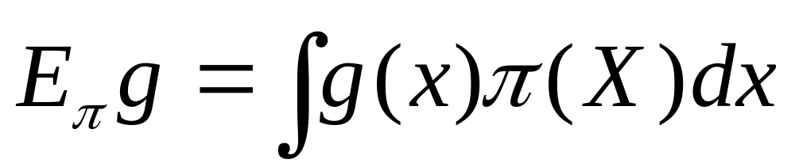
MCMC Sampling Fundamentals
Given a set of variables X = {X₁, X₂, … X_{n}} that represent joint probability distribution π(X) and some function g(X), we can compute expected value of g(X) :
CSE 4109: Artificial Intelligence, Bayesian Network

Slide 50
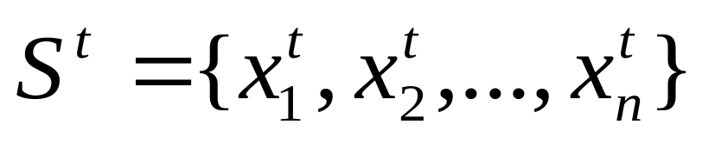
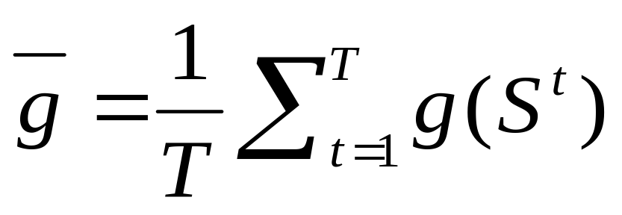
MCMC Sampling From π(X)
A sample S^{t} is an instantiation:
Given independent, identically distributed samples (iid) S¹, S², …S^{T} from π(X), it follows from Strong Law of Large Numbers:
CSE 4109: Artificial Intelligence, Bayesian Network

Slide 51
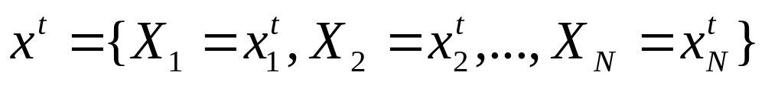
Gibbs Sampling (Pearl, 1988)
A sample t∈[1,2,…],is an instantiation of all variables in the network:
Sampling process
  Fix values of observed variables e
  Instantiate node values in sample x⁰ at random
  Generate samples x¹,x²,…x^{T} from P(x|e)
  Compute posteriors from samples
CSE 4109: Artificial Intelligence, Bayesian Network

Slide 52
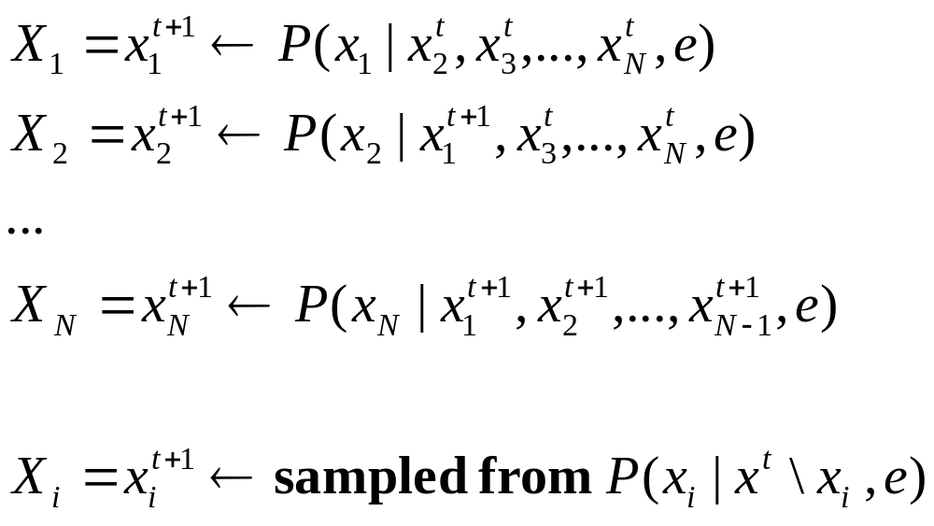
Ordered Gibbs Sampler
Generate sample x^{t+1} from x^{t} :
In short, for i=1 to N:
Process
All
Variables
In Some
Order
CSE 4109: Artificial Intelligence, Bayesian Network

Slide 53

Ordered Gibbs Sampling Algorithm
Input: X, E
Output: T samples {x^{t} }
Fix evidence E
Generate samples from P(X | E)
For t = 1 to T (compute samples)
For i = 1 to N (loop through variables)
X_{i} ← sample x_{i}^{t} from P(X_{i} | markov^{t} \ X_{i})
CSE 4109: Artificial Intelligence, Bayesian Network

Slide 54
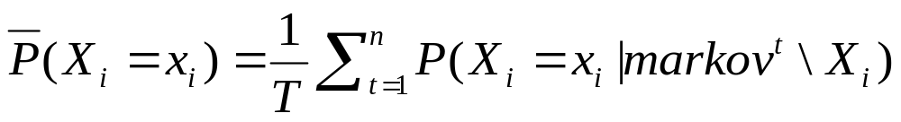
Answering Queries
Query: P(x_{i} |e)
Method 1: count #of samples where X_{i}=x_{i}:
Method 2: average probability (mixture estimator):
CSE 4109: Artificial Intelligence, Bayesian Network

Slide 55
Gibbs Sampling Example - BN
X = {X₁,X₂,…,X₉}
E = {X₉}
X1
X3
X6
X2
X5
X8
X4
X7
X9
CSE 4109: Artificial Intelligence, Bayesian Network

Slide 56
Gibbs Sampling Example - BN
X₁ = x₁⁰ X₆ = x₆⁰
X₂ = x₂⁰ X₇ = x₇⁰
X₃ = x₃⁰ X₈ = x₈⁰
X₄ = x₄⁰
X₅ = x₅⁰
X1
X3
X6
X2
X5
X8
X4
X7
X9
CSE 4109: Artificial Intelligence, Bayesian Network

Slide 57
Gibbs Sampling Example - BN
X₁ ← P (X₁ |X⁰₂,…,X⁰₈ ,X₉}
E = {X₉}
X1
X3
X6
X2
X5
X8
X4
X7
X9
CSE 4109: Artificial Intelligence, Bayesian Network

Slide 58
Gibbs Sampling Example - BN
X₂ ← P(X₂ |X¹₁,…,X⁰₈ ,X₉}
E = {X₉}
X1
X3
X6
X2
X5
X8
X4
X7
X9
CSE 4109: Artificial Intelligence, Bayesian Network

Slide 59
Gibbs Sampling Example – Init
Initialize nodes with random values:
X₁ = x₁⁰ X₆ = x₆⁰
X₂ = x₂⁰ X₇ = x₇⁰
X₃ = x₃⁰ X₈ = x₈⁰
X₄ = x₄⁰
X₅ = x₅⁰
Initialize Running Sums:
    SUM₁ = 0
    SUM₂ = 0
    SUM₃ = 0
    SUM₄ = 0
    SUM₅ = 0
    SUM₆ = 0
    SUM₇ = 0
    SUM₈ = 0
CSE 4109: Artificial Intelligence, Bayesian Network

Slide 60
Gibbs Sampling Example – Step 1
Generate Sample 1
  compute SUM₁ += P(x₁| x₂⁰, x₃⁰, x₄⁰, x₅⁰, x₆⁰, x₇⁰, x₈⁰, x₉ )
  select and assign new value X₁ = x₁¹
  compute SUM₂ += P(x₂| x₁¹, x₃⁰, x₄⁰, x₅⁰, x₆⁰, x₇⁰, x₈⁰, x₉ )
  select and assign new value X₂ = x₂¹
  compute SUM₃ += P(x₂| x₁¹, x₂¹, x₄⁰, x₅⁰, x₆⁰, x₇⁰, x₈⁰, x₉ )
  select and assign new value X₃ = x₃¹
  …..
At the end, have new sample:
S¹ = {x₁¹, x₂¹, x₄¹, x₅¹, x₆¹, x₇¹, x₈¹, x₉ }
CSE 4109: Artificial Intelligence, Bayesian Network

Slide 61
Gibbs Sampling Example – Step 2
Generate Sample 2
  Compute P(x₁| x₂¹, x₃¹, x₄¹, x₅¹, x₆¹, x₇¹, x₈¹, x₉ )
  select and assign new value X₁ = x₁¹
  update SUM₁ += P(x₁| x₂¹, x₃¹, x₄¹, x₅¹, x₆¹, x₇¹, x₈¹, x₉ )
  Compute P(x₂| x₁², x₃¹, x₄¹, x₅¹, x₆¹, x₇¹, x₈¹, x₉ )
  select and assign new value X₂ = x₂¹
  update SUM₂ += P(x₂| x₁², x₃¹, x₄¹, x₅¹, x₆¹, x₇¹, x₈¹, x₉ )
  Compute P(x₃| x₁², x₂², x₄¹, x₅¹, x₆¹, x₇¹, x₈¹, x₉ )
  select and assign new value X₃ = x₃¹
  compute SUM₃ += P(x₂| x₁², x₂², x₄¹, x₅¹, x₆¹, x₇¹, x₈¹, x₉ )
  …..
New sample: S² = {x₁², x₂², x₄², x₅², x₆², x₇², x₈², x₉ }
CSE 4109: Artificial Intelligence, Bayesian Network

Slide 62
Gibbs Sampling Example – Answering Queries
P(x₁|x₉) = SUM₁ /2
P(x₂|x₉) = SUM₂ /2
P(x₃|x₉) = SUM₃ /2
P(x₄|x₉) = SUM₄ /2
P(x₅|x₉) = SUM₅ /2
P(x₆|x₉) = SUM₆ /2
P(x₇|x₉) = SUM₇ /2
P(x₈|x₉) = SUM₈ /2
CSE 4109: Artificial Intelligence, Bayesian Network

Slide 63
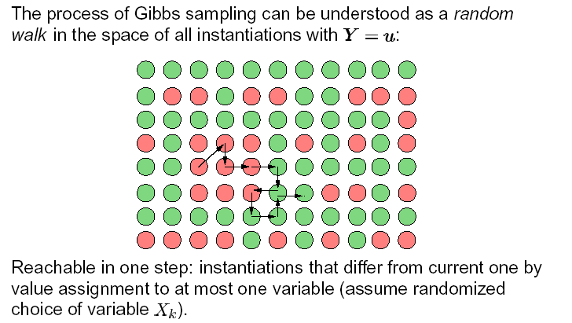
Gibbs Sampling: Illustration
CSE 4109: Artificial Intelligence, Bayesian Network

Slide 64
Gibbs Sampling: Burn-In
We want to sample from P(X | E)
But…starting point is random
Solution: throw away first K samples
Known As “Burn-In”
What is K ? Hard to tell. Use intuition.
CSE 4109: Artificial Intelligence, Bayesian Network

Slide 65
Gibbs Sampling: Performance
+Advantage: guaranteed to converge to P(X|E)
-Disadvantage: convergence may be slow
Problems:
Samples are dependent !
Statistical variance is too big in high-dimensional problems
CSE 4109: Artificial Intelligence, Bayesian Network

Slide 66
Gibbs: Speeding Convergence
Objectives:
Reduce dependence between samples (autocorrelation)
  Skip samples
  Randomize Variable Sampling Order
Reduce variance
  Blocking Gibbs Sampling
  Rao-Blackwellisation
CSE 4109: Artificial Intelligence, Bayesian Network

Slide 67
Skipping Samples
Pick only every k-th sample (Gayer, 1992)
Can reduce dependence between samples !
Increases variance ! Waists samples !
CSE 4109: Artificial Intelligence, Bayesian Network

Slide 68
Randomized Variable Order
Random Scan Gibbs Sampler
Pick each next variable X_{i} for update at random with probability p_{i} , Σ_{i} p_{i} = 1.
(In the simplest case, p_{i} are distributed uniformly.)
In some instances, reduces variance (MacEachern, Peruggia, 1999
  “Subsampling the Gibbs Sampler: Variance Reduction”)
CSE 4109: Artificial Intelligence, Bayesian Network

Slide 69
Blocking
Sample several variables together, as a block
Example: Given three variables X,Y,Z, with domains of size 2, group Y and Z together to form a variable W={Y,Z} with domain size 4. Then, given sample (x^{t},y^{t},z^{t}), compute next sample:
X^{t+1} ← P(y^{t},z^{t})=P(w^{t})
(y^{t+1},z^{t+1})=W^{t+1} ← P(x^{t+1})
+ Can improve convergence greatly when two variables are strongly correlated!
- Domain of the block variable grows exponentially with the #variables in a block!
CSE 4109: Artificial Intelligence, Bayesian Network

Slide 70
Blocking Gibbs Sampling
Jensen, Kong, Kjaerulff, 1993
“Blocking Gibbs Sampling Very Large Probabilistic Expert Systems”
Select a set of subsets:
E₁, E₂, E₃, …, E_{k} s.t. E_{i} ⊂ X
U_{i} E_{i} = X
A_{i} = X \ E_{i}
Sample P(E_{i} | A_{i})
CSE 4109: Artificial Intelligence, Bayesian Network

Slide 71
Rao-Blackwellisation
Do not sample all variables!
Sample a subset!
Example: Given three variables X,Y,Z, sample only X and Y, sum out Z. Given sample (x^{t},y^{t}), compute next sample:
X^{t+1} ← P(y^{t})
y^{t+1} ← P(x^{t+1})
CSE 4109: Artificial Intelligence, Bayesian Network

Slide 72
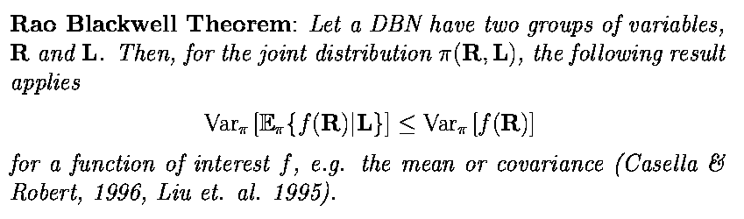
Rao-Blackwell Theorem
Bottom line: reducing number of variables in a sample reduce variance!
CSE 4109: Artificial Intelligence, Bayesian Network

Slide 73
Blocking vs. Rao-Blackwellisation
Standard Gibbs:
P(x|y,z),P(y|x,z),P(z|x,y) (1)
Blocking:
P(x|y,z), P(y,z|x) (2)
Rao-Blackwellised:
P(x|y), P(y|x) (3)
Var3 < Var2 < Var1
[Liu, Wong, Kong, 1994
Covariance structure of the Gibbs sampler…]
X
Y
Z
CSE 4109: Artificial Intelligence, Bayesian Network

Slide 74
Geman&Geman1984
Geman, S. & Geman D., 1984. Stocahstic relaxation, Gibbs distributions, and the Bayesian restoration of images. IEEE Trans.Pat.Anal.Mach.Intel. 6, 721-41.
  Introduce Gibbs sampling;
  Place the idea of Gibbs sampling in a general setting in which the collection of variables is structured in a graphical model and each variable has a neighborhood corresponding to a local region of the graphical structure. Geman and Geman use the Gibbs distribution to define the joint distribution on this structured set of variables.
CSE 4109: Artificial Intelligence, Bayesian Network

Slide 75
Tanner&Wong 1987
Tanner and Wong (1987)
  Data-augmentation
  Convergence Results
CSE 4109: Artificial Intelligence, Bayesian Network

Slide 76
Pearl1988
Pearl,1988. Probabilistic Reasoning in Intelligent Systems, Morgan-Kaufmann.
  In the case of Bayesian networks, the neighborhoods correspond to the Markov blanket of a variable and the joint distribution is defined by the factorization of the network.
CSE 4109: Artificial Intelligence, Bayesian Network

Slide 77
Gelfand&Smith,1990
Gelfand, A.E. and Smith, A.F.M., 1990. Sampling-based approaches to calculating marginal densities. J. Am.Statist. Assoc. 85, 398-409.
  Show variance reduction in using mixture estimator for posterior marginals.
CSE 4109: Artificial Intelligence, Bayesian Network

Slide 78
Neal, 1992
R. M. Neal, 1992. Connectionist learning of belief networks, Artifical Intelligence, v. 56, pp. 71-118.
  Stochastic simulation in noisy-or networks.
CSE 4109: Artificial Intelligence, Bayesian Network

